Slide 1
Boulder72
A Video Storyboard

Slide 2
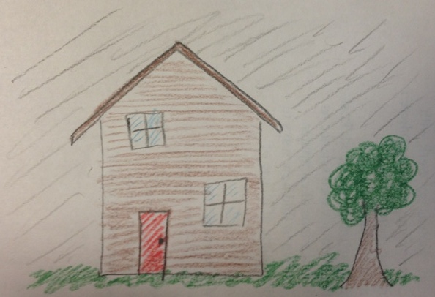
Notes:
Exterior shot of a house. Sounds of thunder and lightning

Slide 3
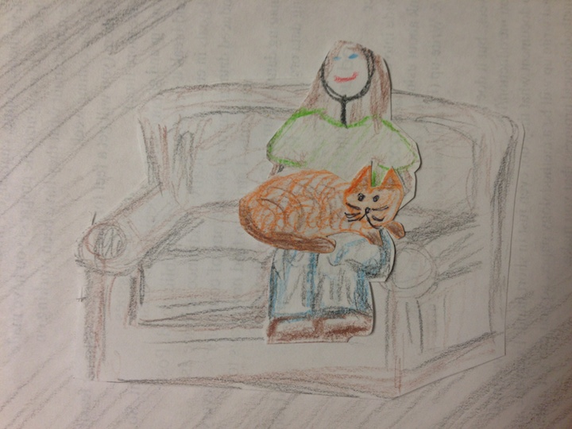
Notes:
Leif is out of town with the twins. Buffy is home alone with the family cat.

Slide 4
Notes:
We hear the sound of local news reporting flash flooding all over Boulder County.

Slide 5
Notes:
Closeup shot of the exterior window

Slide 6
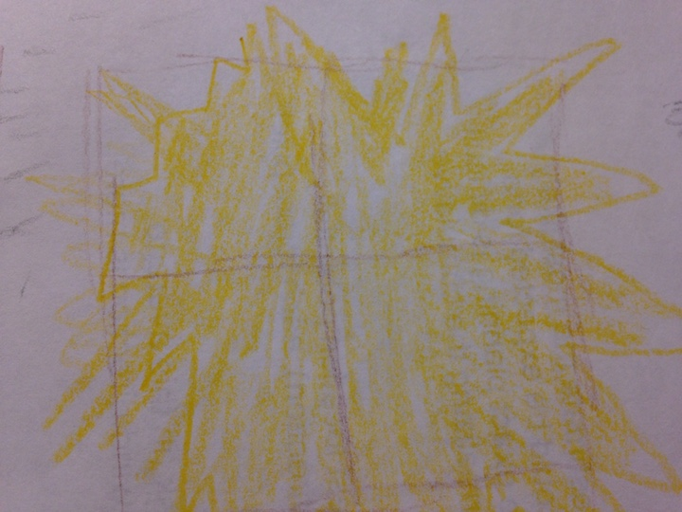
Notes:
Lightning strikes again

Slide 7
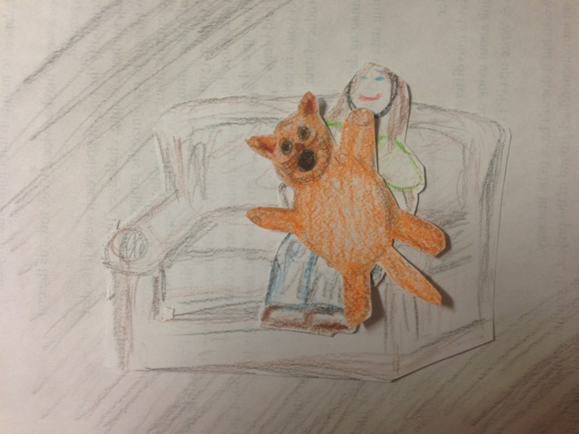
Notes:
Buffy jumps and the cat’s claws dig into her legs.

Slide 8
Notes:
The lights goes out and the scene goes dark. The power has gone out.
Buffy says “Oh no, the power has gone out on the whole block”

Slide 9
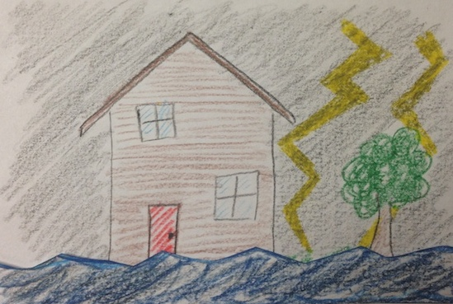
Notes:
Buffy looks out the window and, in the light from the lightning, sees the water rising on the lawn.

Slide 10
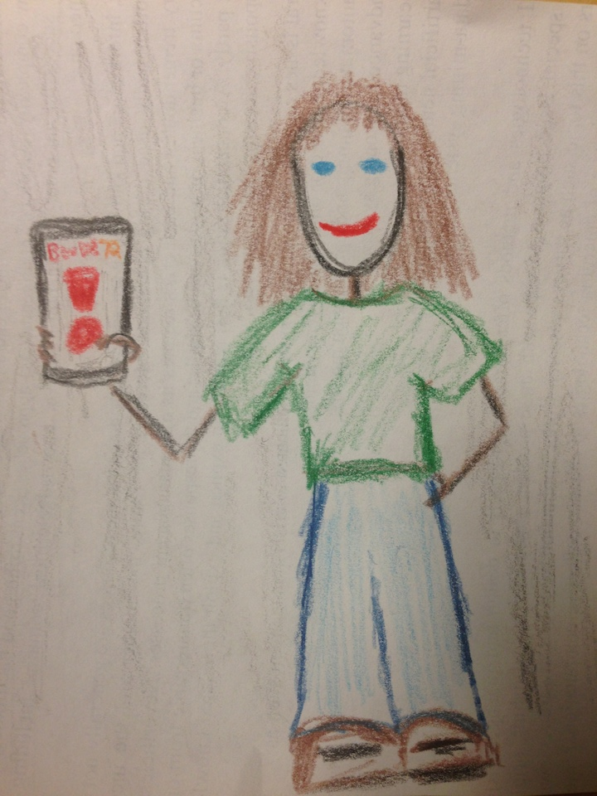
Notes:
She pulls out her phone and launches the Boulder72 app.

Slide 11
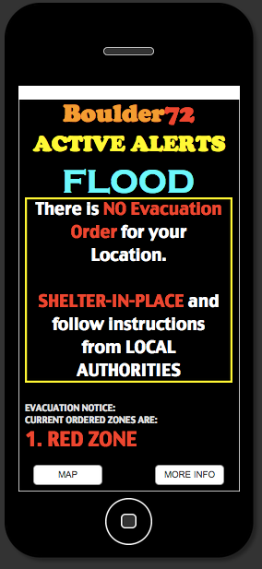
Notes:
CLOSEUP: Phone
Buffy clicks on the “Alerts” icon and is brought to the alert page which shows her location on a map with an overlaid evacuation area.
“THERE IS NO EVACUATION ORDER SET FOR YOUR LOCATION. SHELTER IN PLACE AND CONTINUE TO FOLLOW UPDATES FROM LOCAL AUTHORITIES”

Slide 12
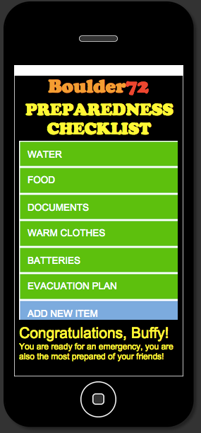
Notes:
Buffy immediately clicks the preparedness tab of the app to check on her preparedness.
The app says that she has prepared with all the items recommended by the Boulder Office of Emergency Management, including her documents, food, batteries and warm clothes in a safe place.

Slide 13
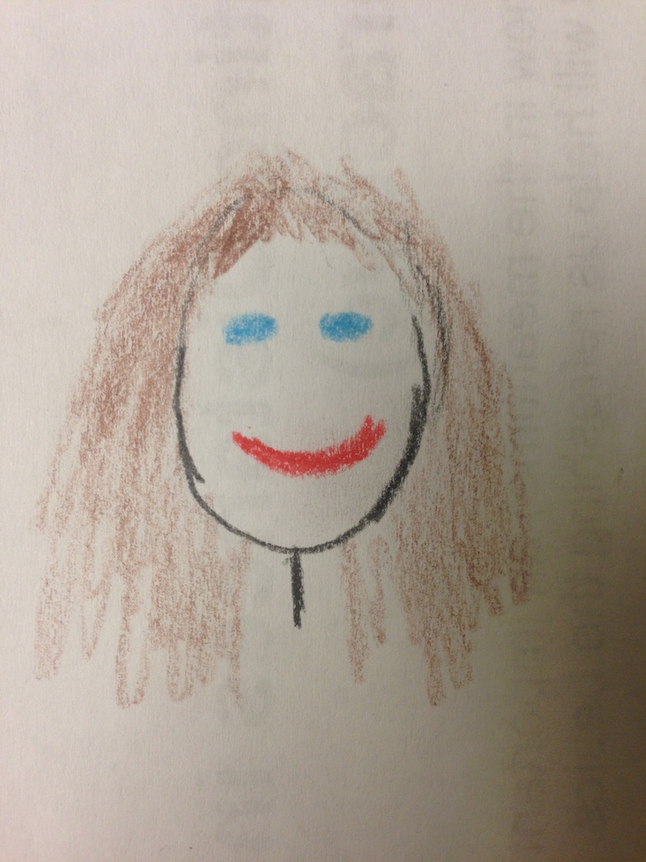
Notes:
CLOSEUP: Buffy’s face
She thinks immediately of checking on her friend Dana who has recently moved to the locality and might need help.
“Dana lives right by the creek. I’d better make sure she’s ok!”

Slide 14
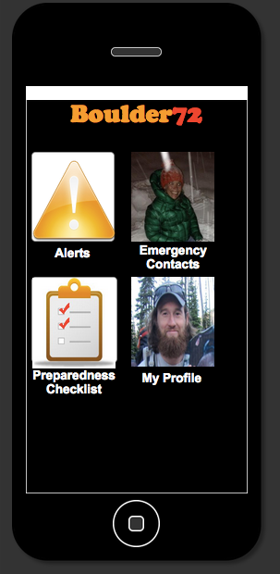
Notes:
Buffy clicks on the emergency contacts tab of the app,selects Dana and pings her. The app says that the ping has been sent.

Slide 15
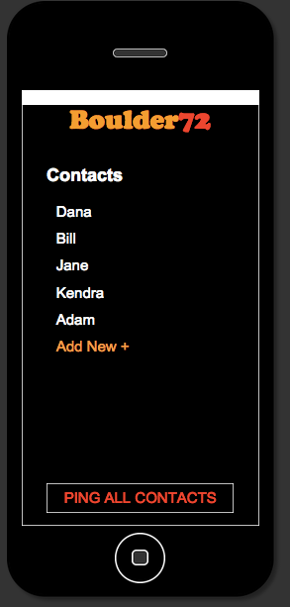

Slide 16
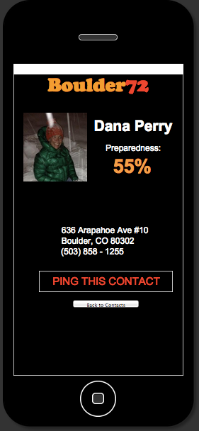

Slide 19
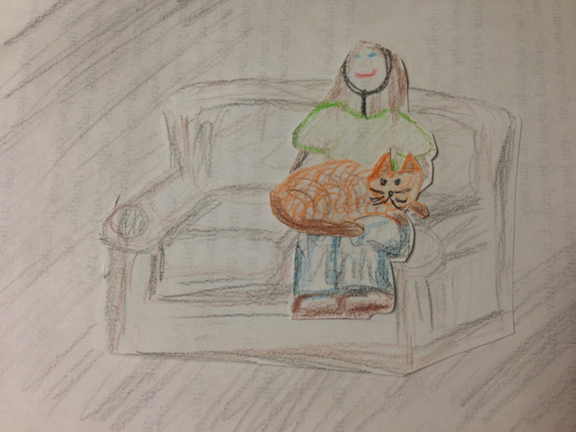

Slide 20
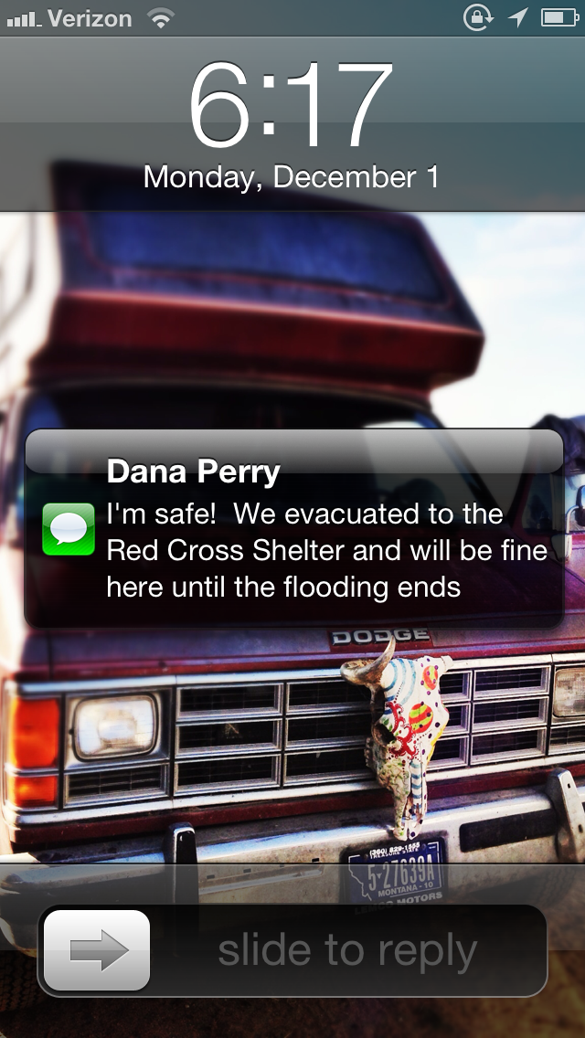
Notes:
Buffy gets a response that Dana is safe

Slide 21
Notes:
Buffy relaxes back on her couch with her cat to wait out the storm, safe and sound.

